Slide 1
Compassionate C-sections: Skin to Skin Care to Include the Family
Heidi A. Lyn, M.D.
Deborah J. Eganhouse, PhD, RNC-OB

Slide 2
Objectives
Describe the positive physiological benefits of skin-to-skin (STS) care.
Describe the positive psychological benefits of STS care.
Define interventions in the operative suite that enhance the birth experience.
Define interventions in patient hand-off that enhance family-centered care.

Slide 3
The Natural Caesarean
Originally described by Smith, Plaat and Fisk
2008
Australia

Slide 4
Preparation
OR tour for patient and partner
Patient may provide music of her choice
Patient may wear her own clothing
IV in non-dominant arm
EKG leads away from maternal anterior chest wall
Pulse oximeter on mother’s foot
Mothers arms not strapped down

Slide 5
Delivery
The mother’s head is raised and the drape lowered
The fetal head enters the abdominal incision
The fetus auto-resuscitates
After crying, delivery of the torso is assisted
The fetus is half delivered for up to a minute
Passive and active birth continue
The cord is clamped and cut

Slide 6
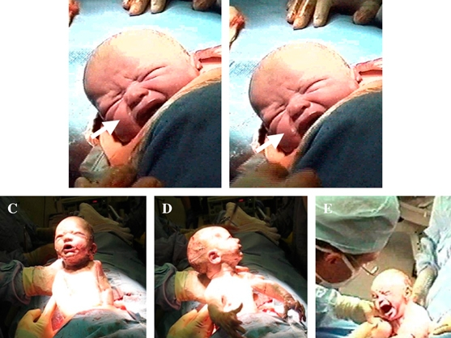

Slide 7
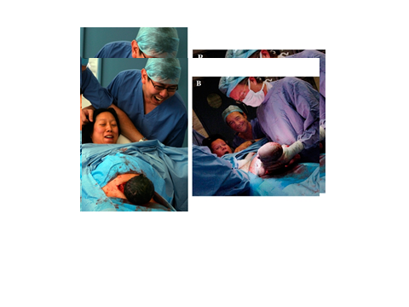

Slide 8
Immediate Skin to Skin
A scrubbed midwife moves to the head of the bed and takes the baby from the surgeon
The baby is placed between the mother’s breasts
The baby is dried with warm towels
Hospital bands, vitamin K are done with the newborn on the maternal chest
Breastfeeding is facilitated
Weighing is delayed

Slide 9
Maternal Benefits of STS
Reduced anxiety
Increased mutuality and reciprocity with the neonate
Preference for STS with subsequent births
Higher breastfeeding rates
Greater patient satisfaction

Slide 10
STS in the OR, and breastfeeding
Of 4 QI projects and one RCT evaluating the breastfeeding rate, 3 demonstrated an increase in the breastfeeding rate at hospital discharge.

Slide 11
Delayed Cord Clamping
Neonates who had delayed cord clamping during cesarean birth ( more than 30 sec) had the same residual blood volume as those who had immediate cord clamping
3 RCT demonstrated higher blood volume, initial mean blood pressure, and mean glucose levels
Note: neonate was held at or below the level of the incision

Slide 12
Autoresuscitation
No significant differences in pH, or Apgar scores
May increase placental transfusion to the neonate during the slower expulsion, resulting in increased red blood cell mass ( one study)

Slide 13
Delayed Cord Clamping
Neonates who had delayed cord clamping during cesarean birth ( more than 30 sec) had the same residual blood volume as those who had immediate cord clamping
3 RCT demonstrated higher blood volume, initial mean blood pressure, and mean glucose levels
Note: neonate was held at or below the level of the incision

Slide 14
Neonatal Temperature
Vanderbilt modification: 5 minute assessment is done before skin to skin
Baby is dried under a warmer
Baby is placed skin to skin with mother, and covered with warm blankets and/or a forced air warming system
Rectal temperatures in a medical record review of 47 neonates showed all had normal rectal temperatures at conclusion of skin to skin

Slide 15
Implementation of STS in the OR: Identify Stakeholders
Anesthesia services
Community doula
Family advocate
L&D nurse
Neonatal NP
Neonatologist
Nurse from newborn nursery
Physician from newborn nursery
Nurse midwife
Obstetrician
Scrub technician
Women’s services administrator

Slide 16
Implementation
In US, a windowed drape has been adopted at many institutions
5 minute delay in STS for drying and assessment
Kangaroo care
Family centered cesarean birth nurse: dedicated personnel

Slide 17


Slide 18
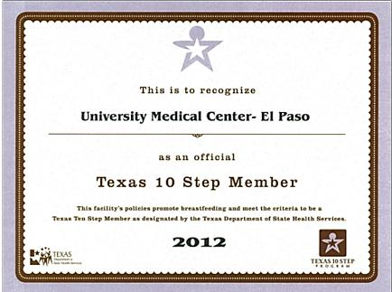
UMC is A Texas Ten Step Hospital

Slide 19
What is the Baby-Friendly Hospital Initiative (BFHI)?
A recognition program for maternity facilities that have created an optimal environment for appropriate infant feeding and mother-baby bonding.
An international program co-administered by the World Health Organization (WHO) and the United Nations Children’s Fund (UNICEF) in conjunction with national BFHI authorities.
19
Copyright 2010 Baby-Friendly USA, Inc.

Slide 20
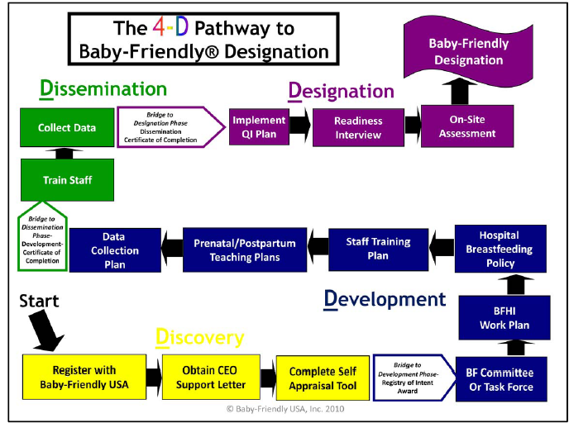
20

Slide 21
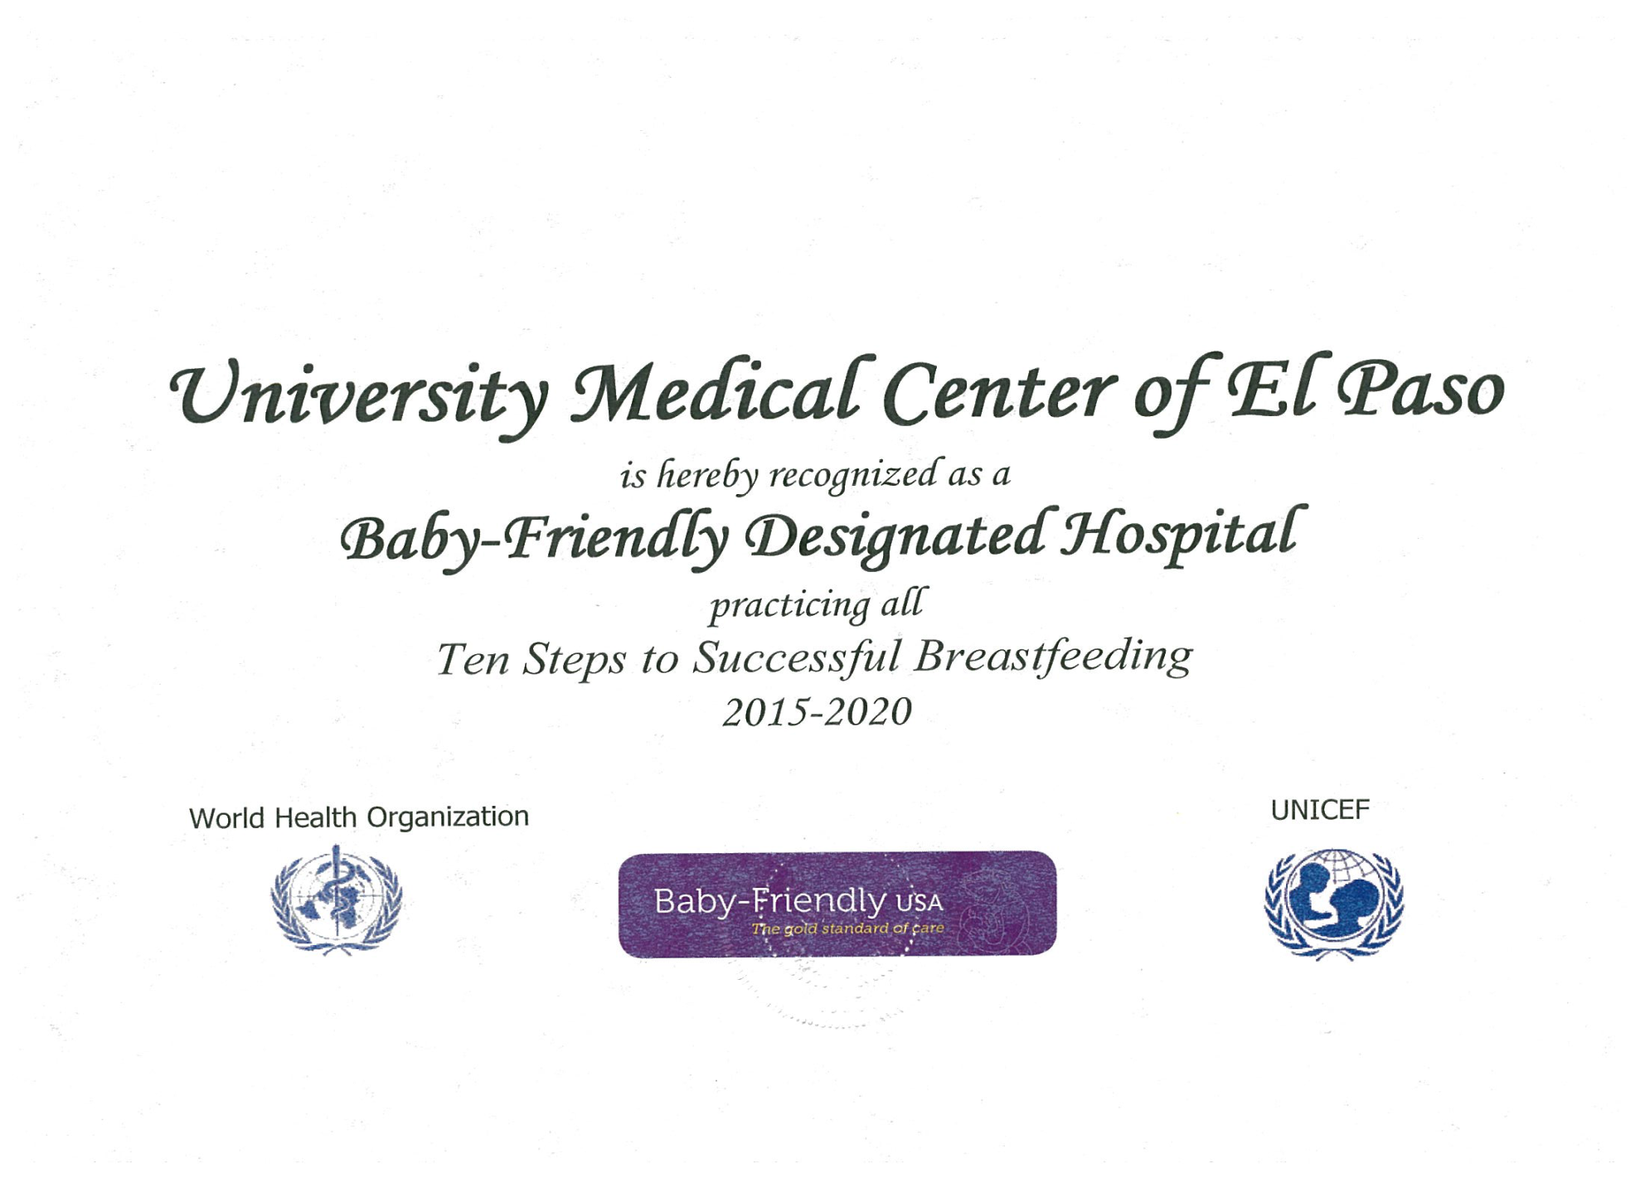

Slide 22
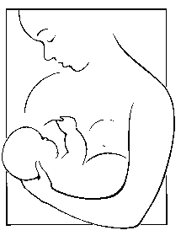
UMC-El Paso
Baby-Friendly® 2015
Designation rec’d July 7, 2015
1st hospital in El Paso
3rd US-MX Border Hospital
11th Hospital in Texas
277th Hospital in U.S.

Slide 23
Why Breastfeeding is Important
Diabetes is reduced
Over-feeding and obesity is reduced
Babies are more healthy
APA “babies first vaccine”
Risks for uterine and breast cancer are reduced
Less cost and no preparation
Babies receive the best start regardless of socio-economic status

Slide 24
Definition of STS
Placement of a naked infant (cap on)
Against the mother’s bare skin
Exposed mother and infant are covered with a warm blanket or towels
Kangaroo care generally refers to care of the preterm infant in NICUs
Should be implemented immediately following birth
Should not be interrupted by healthcare routines until after the first feed

Slide 25
Breastfeeding Issues & C-Birth
Less likely to initiate breastfeeding
Report more difficulties while establishing BF
Delay in breastfeeding initiation is associated with delayed lactogenesis stage and duration of breastfeeding.

Slide 26
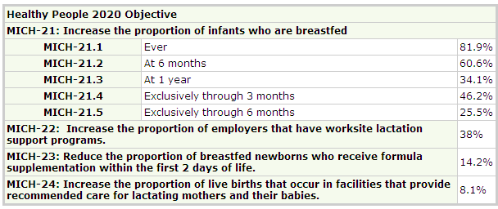
Healthy People 2020 Goals
26
http://www.cdc.gov/breastfeeding/data/reportcard.htm

Slide 27
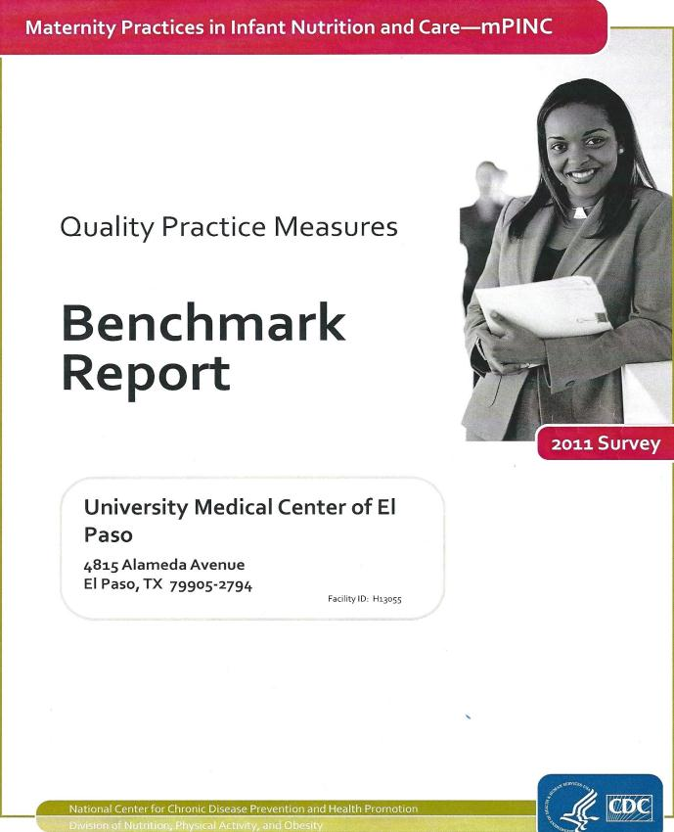
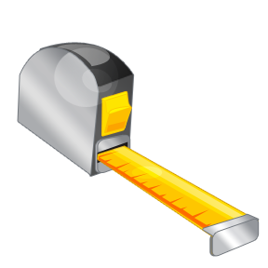
Benchmarks
90 %

Slide 28
Maternity Practices in Infant Nutrition & Care
External Benchmark
CDC Survey: “Voluntary,” confidential, data aggregated by state for regional comparisons
Ranked for US, state & size of hospital
Began in 2007, 2009, 2011, 2013, 2015
Purpose: 2003, an expert panel of researchers with experience in surveillance and monitoring of hospital practices related to breastfeeding convened by CDC recommended establishment of an ongoing, national system to monitor and evaluate hospital practices related to breastfeeding among all facilities that routinely provide intrapartum care in the United States

Slide 29
mPINC Scores & Ranks
TX & UMC
Year | TX Comp. Score | TX % Rank | UMC Comp. Score | UMC US % Rank | UMC TX % Rank
2013 | 73 | 33 | 92 | 90 | 92
2011 | 66 | 36 | 65 | 37 | 47
2009 | 62 | 33
2007 | 58 | 39

Slide 30
Cesarean Birth Questions from mPINC
Approximately how many mothers are encouraged to hold their healthy full-term infants STS for at least 30 minutes within 2 hours after delivery for uncomplicated cesarean births?
Rarely (0-9%)
Sometimes (10-49%)
Often (50%-89%)
Almost Always (90%-100%)

Slide 31
Baby-Friendly Criteria--Interview
Step 4: Help mothers initiate breastfeeding within one hour of birth.
Guideline: After cesarean birth mothers will report that their babies were place in continuous uninterrupted STS contact….as soon as the mother was responsive.
Criteria : At least 80% will confirm that their babies were placed in STS contact with them as soon as the mother was responsive…..

Slide 32
Uncomplicated V-Birth & C-Birth
(Couplets)

Slide 33
Complicated (Separated)
V-Birth & C-Births 2013-2014
2013-2014

Slide 34
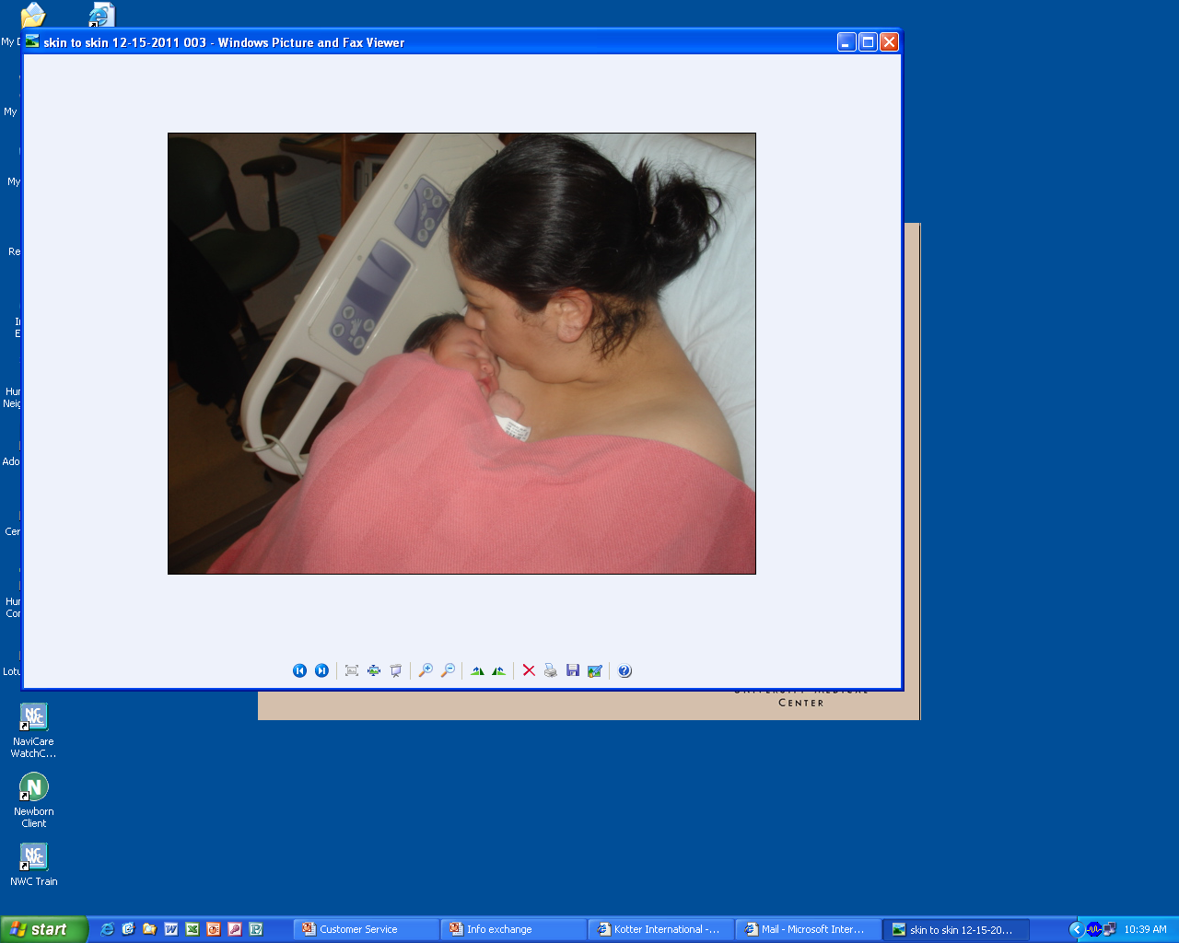
Skin-To-Skin—”Its Love….”

Slide 35
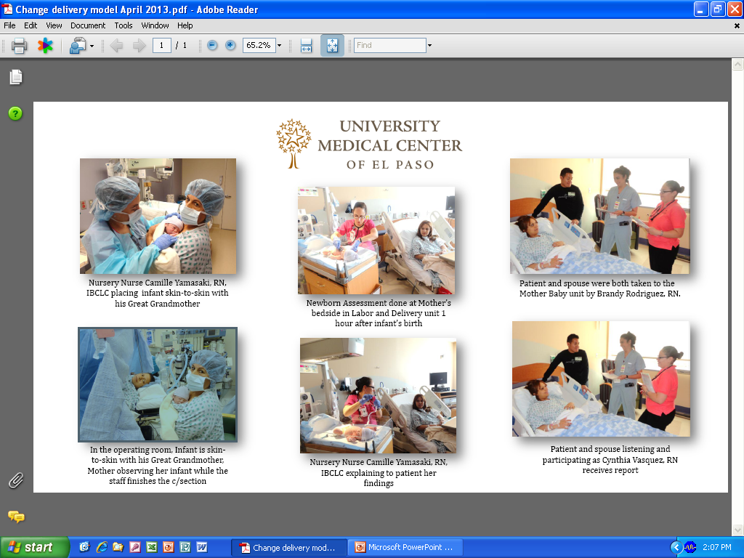
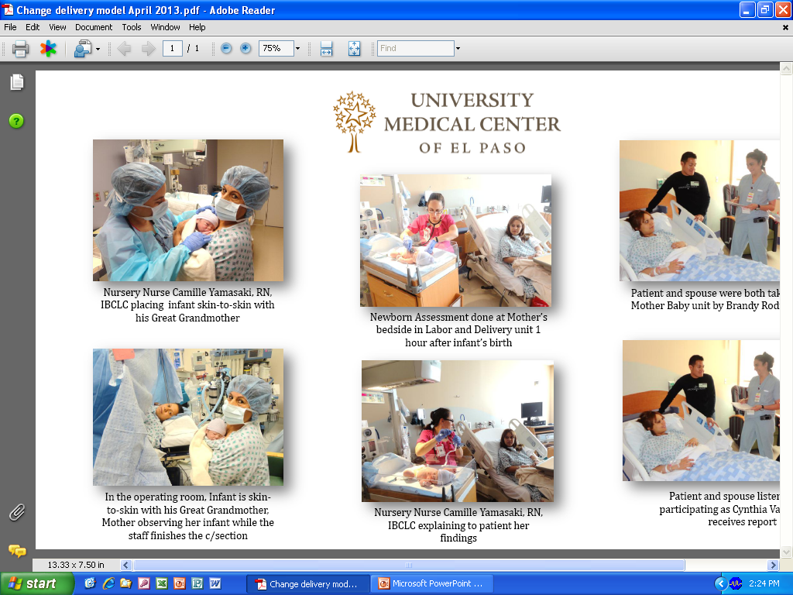

Slide 36
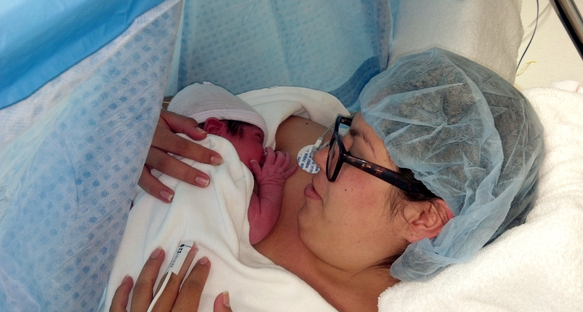
Skin to Skin During C/S

Slide 37
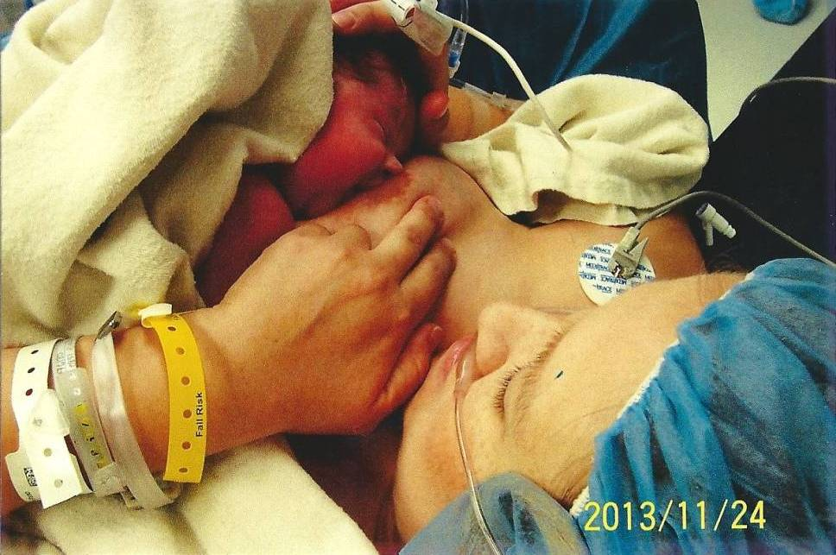
11-25-13 Latch in the UMC OR

Slide 38
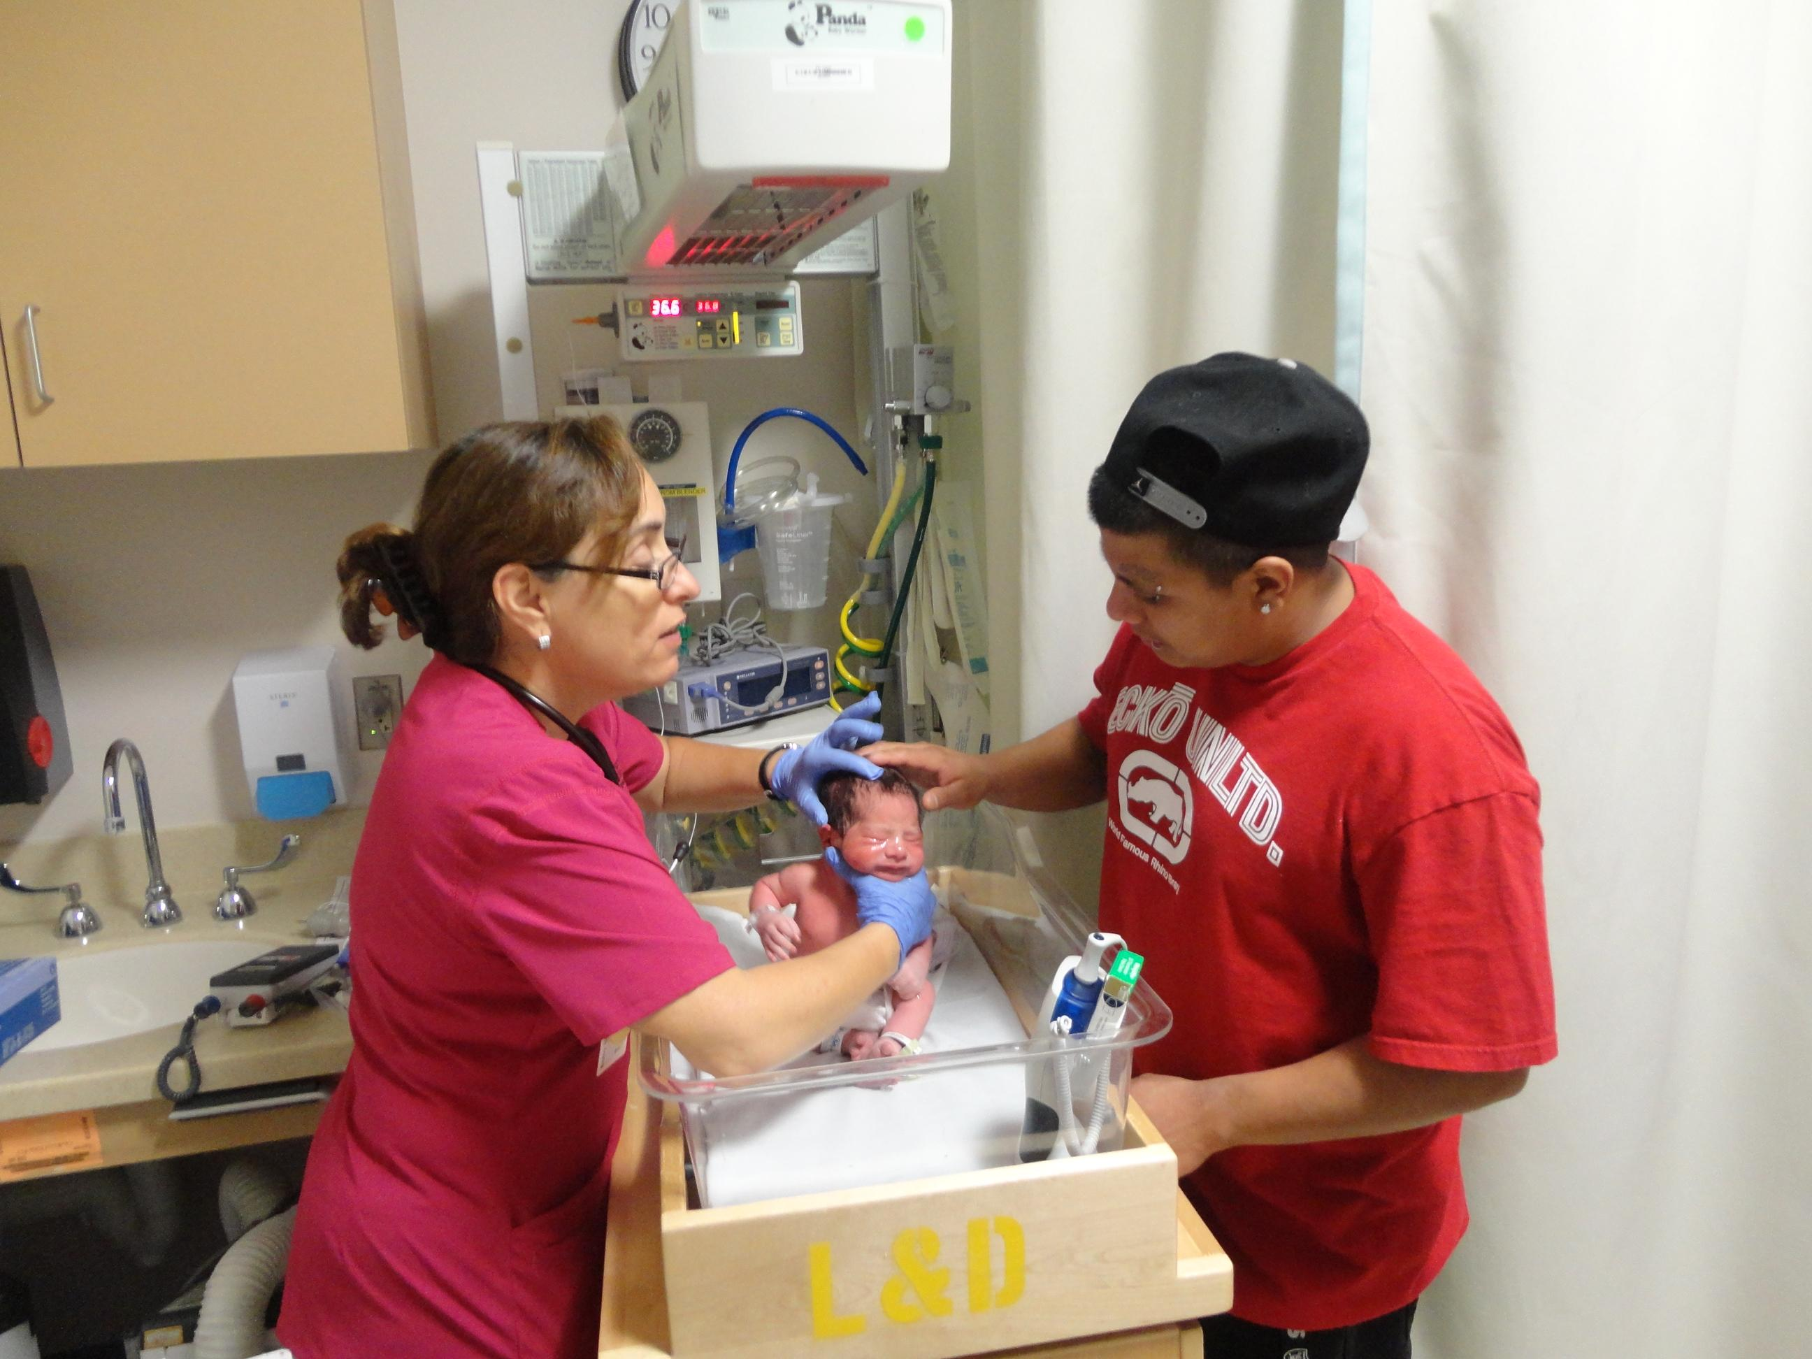
Dad Meets his New Baby

Slide 39
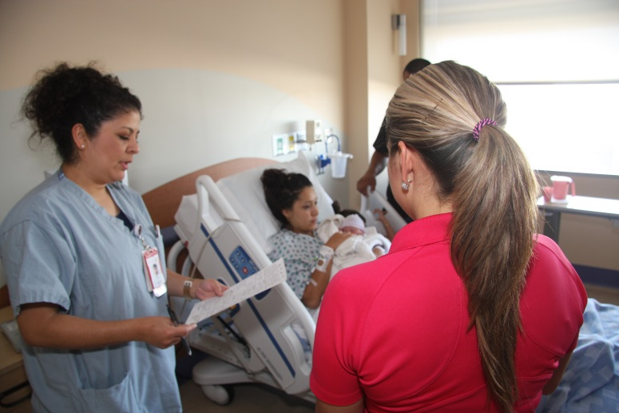
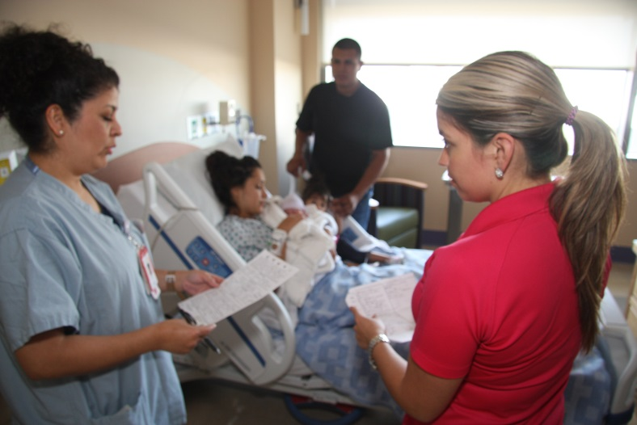
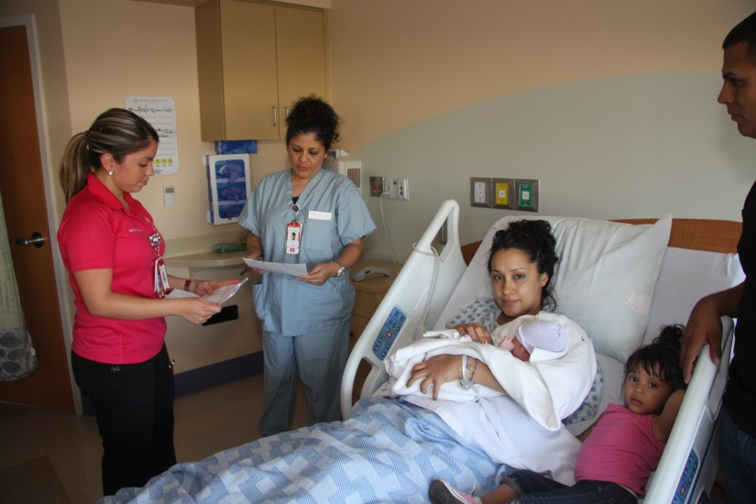
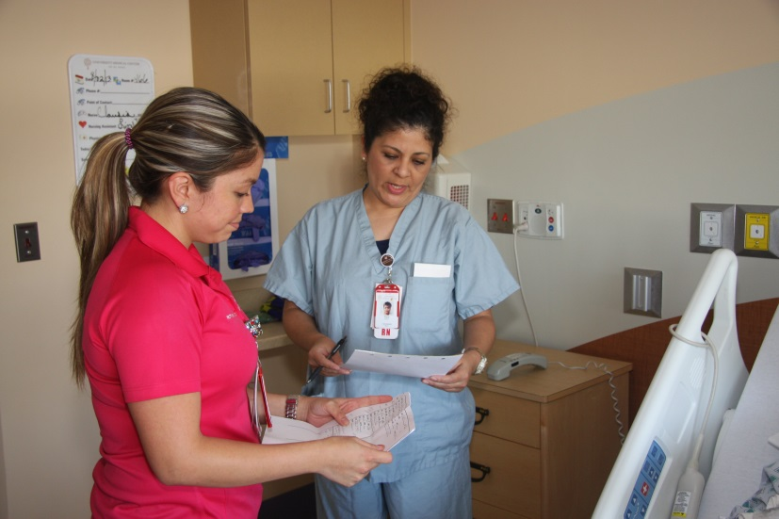
RN to RN Report in the M/B Room

Slide 40
STS Rates for V-Births & C-Births
1-13 to 12-14 (97% vs. 90%)

Slide 41
C-Birth STS & Breastmilk as First Feed Rates--2013-2014 (90% 83%)

Slide 42
Breastmilk as First Feed
V (93%) & C-Birth (83%)—2014 to 2015

Slide 43
UMC Couplet Transfer—L&D to MBU--2013 to 2014

Slide 44
What’s Next?

Slide 45
Exclusive Breastfeeding Rate @ Discharge 2012-2015

Slide 46
Keeping the Momentum
Quarterly data must be submitted to BFHI
2020 is the year of re-designation
Documentation of medical indication for supplementation is required.
Education for new residents and faculty
Be an advocate for breastfeeding in the clinic and the hospital

